Slide 1
Factors affecting room pricing in
OYO Hotels
Presented by
Ishika Goel (MABSPG23002)

Slide 2
Objective: To analyze the OYO Hotel Rooms dataset using SQL to discover patterns and insights that influence room pricing, availability, and customer preferences.
Dataset: OYO Hotel Rooms dataset with attributes like hotel name, room price, location, ratings, and room availability.
Key Focus: Identifying trends in pricing based on various factors such as location, rating, room type, and availability.

Slide 3
Problem Statement
Main Problem: How do different factors like location, customer ratings, and room type influence room pricing in OYO hotels?
Goal: To identify actionable insights to optimize pricing strategies, room availability, and customer satisfaction at OYO Hotels.

Slide 4
Dataset Overview
Attributes:
room_id: Unique identifier for each room.
hotel_name: The name of the hotel.
room_price: Price of the room.
location: City or geographical location of the hotel.
rating: Customer rating (e.g., 1 to 5 stars).
availability: Whether the room is available (available or not available).
room_type: Category of room (if available, e.g., deluxe, suite).
Data size:
(460,6)

Slide 5
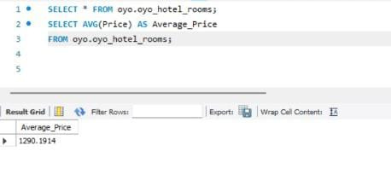
Question 1. What is the average room price across all locations?
Objective: Understand the baseline pricing of rooms across the entire dataset.
Key Insight: This will provide the overall average price, helping us set a baseline for comparisons.

Slide 6
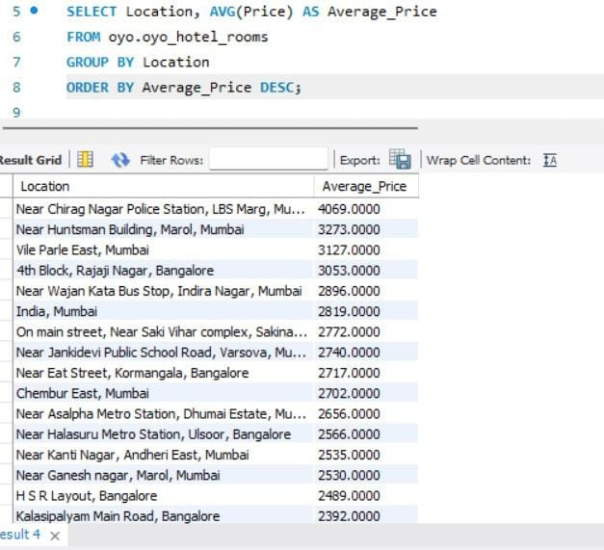
Question 2. How does the average room price vary by location?
Objective: Identify the geographical impact on room pricing.
Key Insight: We can pinpoint high-cost locations and compare them to lower-cost areas, helping OYO tailor its pricing strategy.

Slide 7
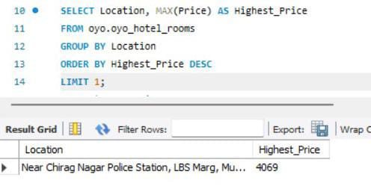
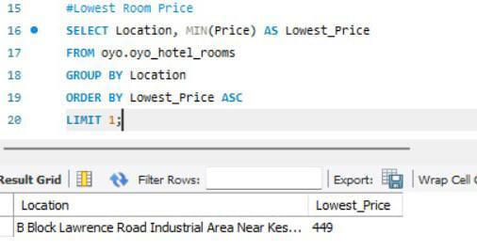
Question 3. Which locations have the most expensive and least expensive rooms?
Objective: Highlight outliers in terms of pricing.
Key Insight: This reveals the price range across locations, aiding decisions for premium pricing or discounts.

Slide 8
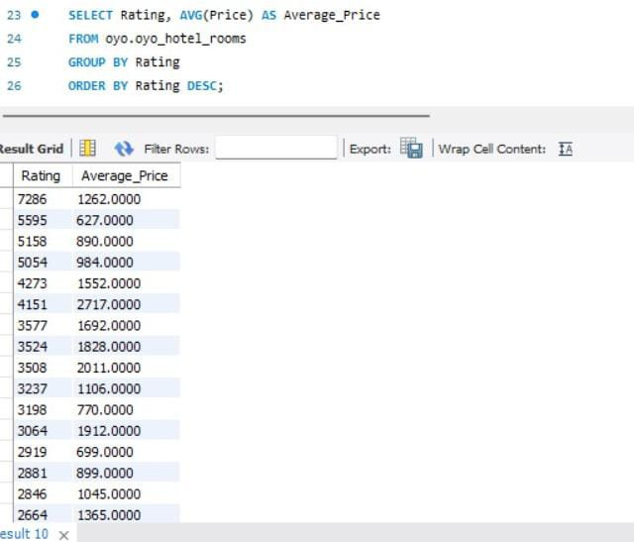
Question 4. Is there a correlation between customer ratings and room pricing?
Objective: Assess whether better-rated hotels charge more for their rooms.
Key Insight: If higher ratings correspond to higher prices, OYO can use ratings as a marketing tool for premium rooms.

Slide 9
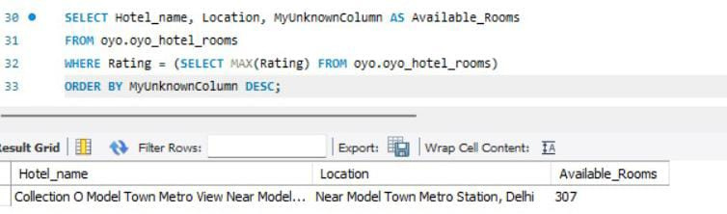
Question 5. What is the availability of rooms in top-rated hotels?
Objective: Examine the relationship between hotel ratings and room availability.
Key Insight: This helps determine whether high-rated hotels often have more available rooms, which can signal either higher supply or lower demand.

Slide 10
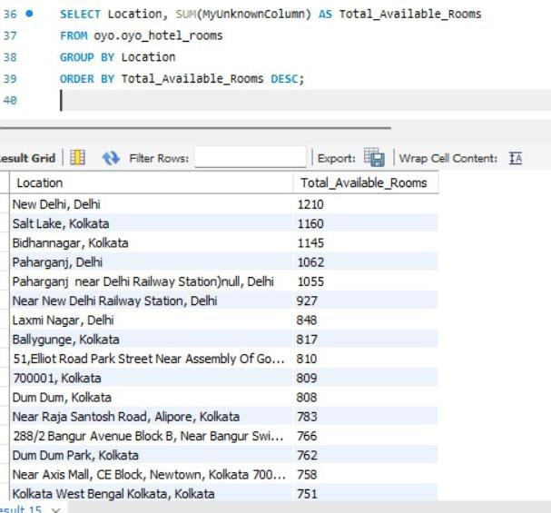
Question 6. Which room types (if available) are most and least expensive?
Objective: Analyze whether certain room types have consistent price trends.
Key Insight: Understanding the price distribution among room types can help OYO market specific rooms more effectively.

Slide 11
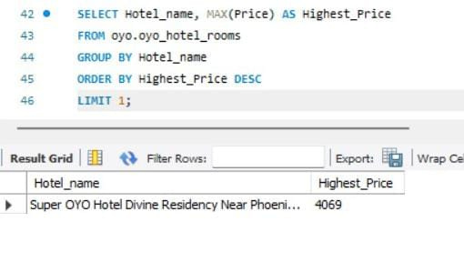
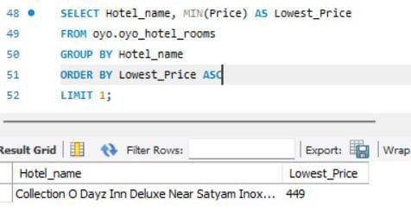
Question 7. How does room availability differ by location?
Objective: Identify if certain locations have consistently more or fewer available rooms.
Key Insight: This helps OYO understand which locations may need more inventory or marketing to fill available rooms.

Slide 12
Key Findings:
Locations with high average prices are typically tourist-heavy or premium areas.
Higher-rated hotels tend to charge more for rooms, but their availability may vary based on location and demand.
There is a price discrepancy between different room types and locations, which could indicate the need for targeted pricing strategies.

Slide 13
Solutions:
Implement location-based dynamic pricing to adjust prices in real-time based on demand and availability.
Encourage better-rated hotels to increase visibility and justify higher pricing, while offering deals to improve ratings in lower-rated properties.
Increase room availability in high-demand locations or invest in partnerships to boost supply where needed.

Slide 14
Conclusion:
The analysis reveals key factors such as location, ratings, and room type that significantly impact room pricing and availability. By leveraging this information, OYO can optimize pricing strategies, marketing efforts, and customer satisfaction.

Slide 15

Thank You

